Slide 1
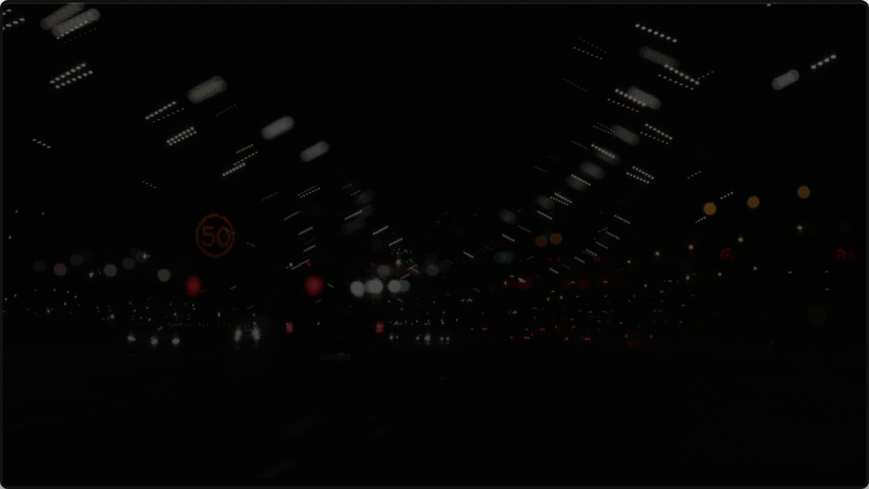

CSS 497
ROAD SIGN & TRAFFIC LIGHT DETECTION
By Ishaan & Manish
Notes:
Manish

Slide 2


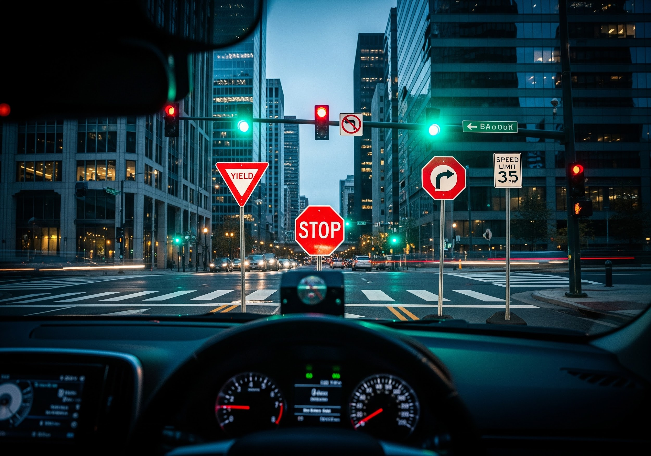
PROJECT OVERVIEW
Introduction
This project focuses on a classical computer vision approach to detect and classify traffic signals and road signs in real-time. Built strictly in C++ with OpenCV, the system avoids "black box" models in favor of explainable geometric and color-based logic.
Key Applications
• Autonomous Vehicles: Core navigation and safety protocols.
• ADAS Systems: Driver assistance for speed and signal alerts.
• Smart City Infrastructure: Real-time traffic flow monitoring.
Notes:
Ishaan

Slide 3
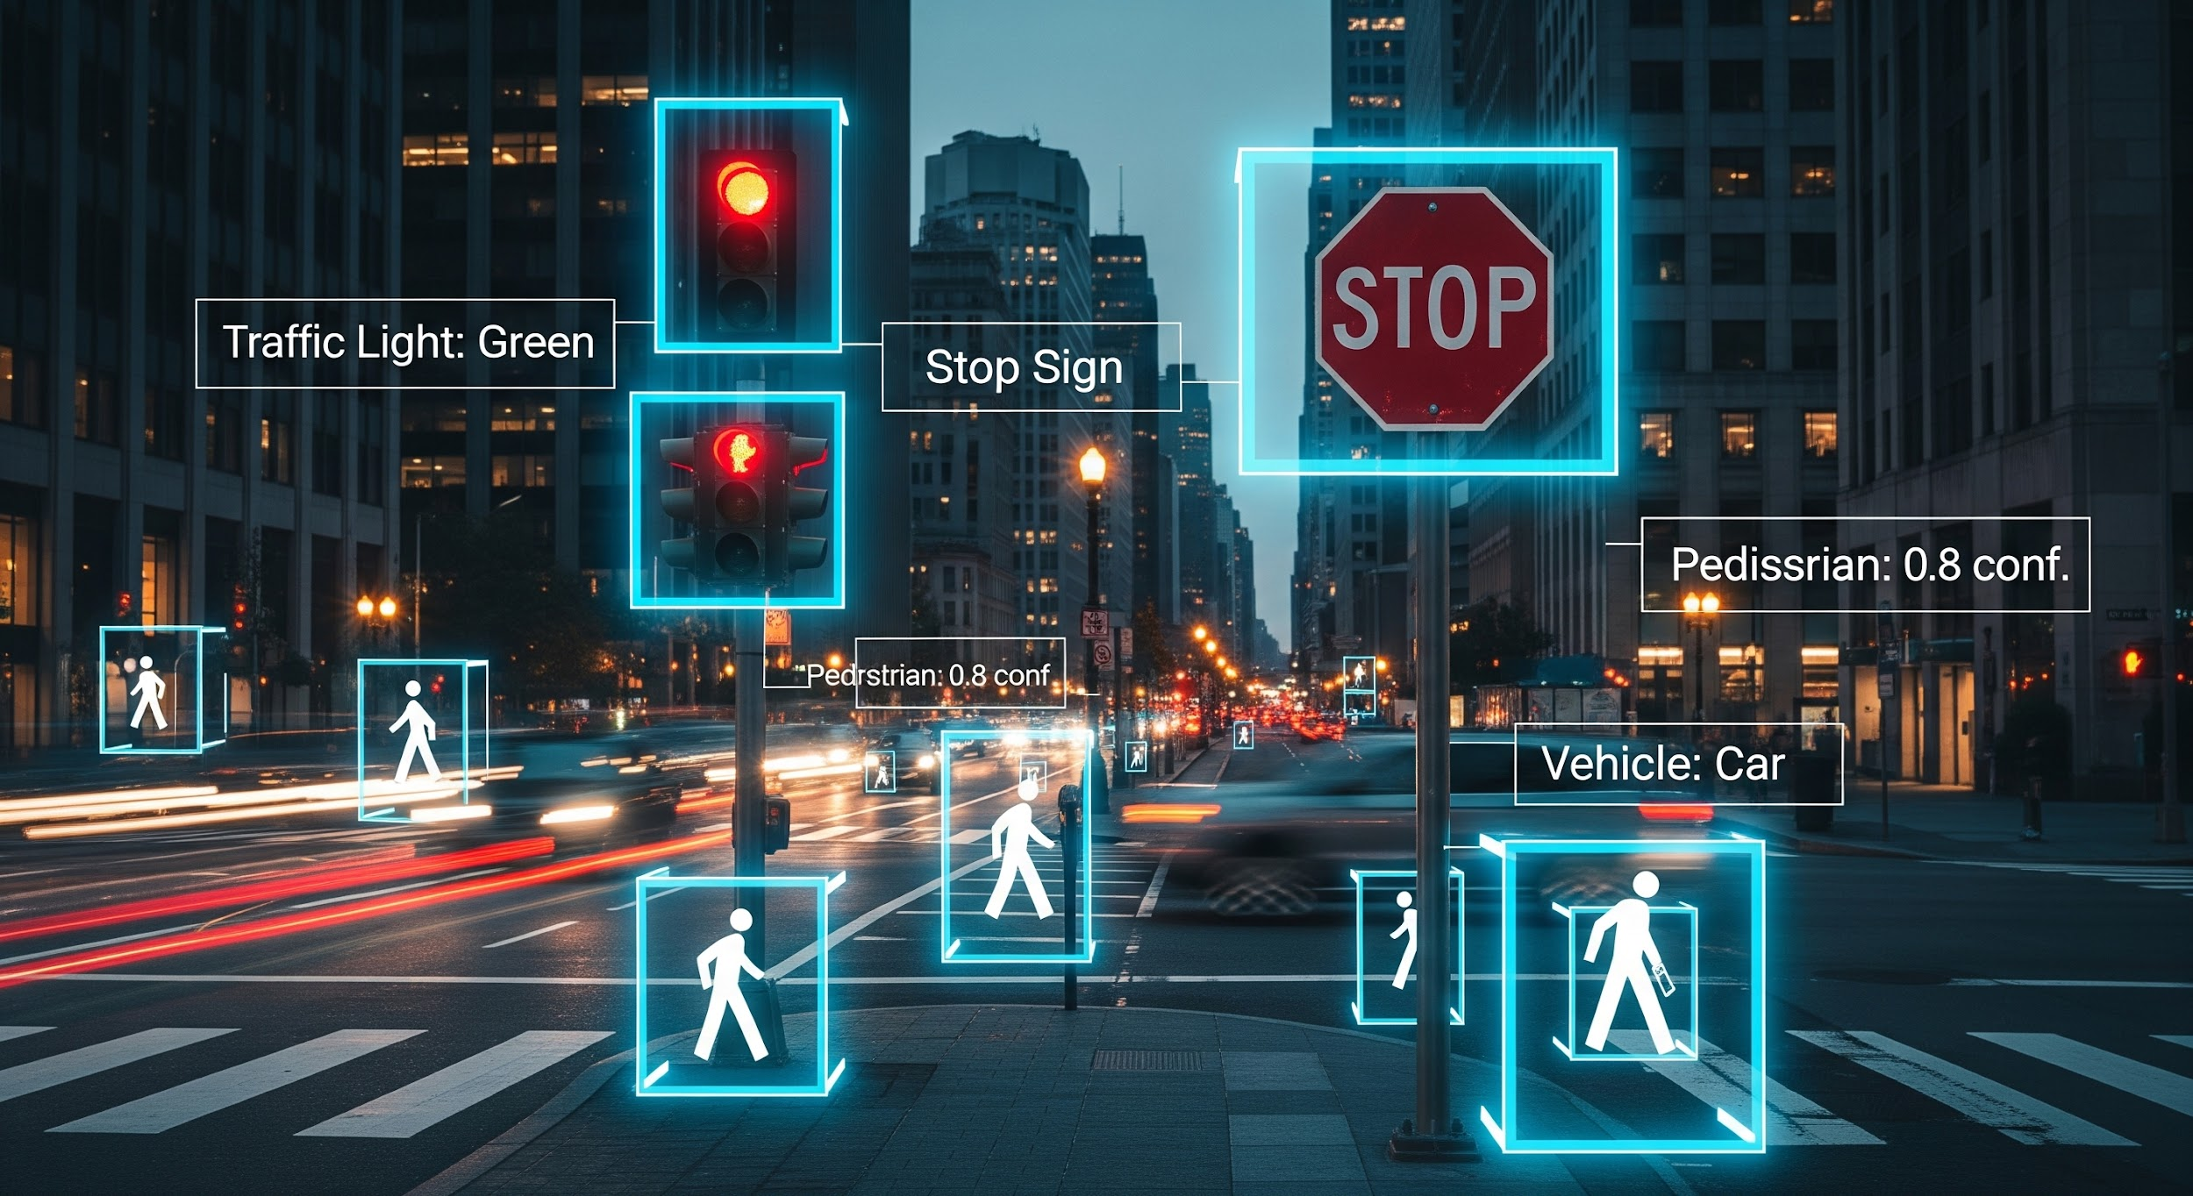
PROJECT GOALS & OBJECTIVES
THE TARGET METRIC
92%
Detection Accuracy
CORE MILESTONES
Reliable classification of 10+ sign types
Sub-50ms processing latency per frame
Minimize false detections in videos
Our primary objective is to engineer a robust, real-time detection pipeline that translates raw visual data into precise environmental awareness.
Notes:
Ishaan

Slide 4


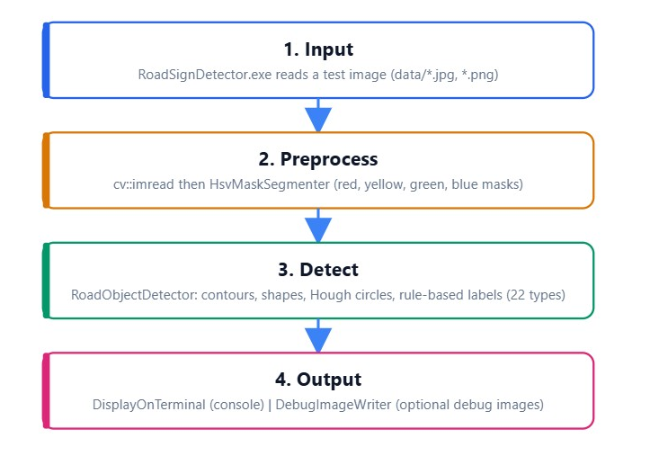
SYSTEM ARCHITECTURE
A strict, sequential algorithmic pipeline.
Built strictly in C++ utilizing the powerful OpenCV library for high-speed image processing.
Attribute Recognition: The system detects signs using fundamental color, shape, text, and symbol-based rules.
Transparent Logic: Every detection can be traced back to a specific geometric or color calculation.
Real-world Application: Designed to process standard RGB images into actionable traffic commands.
Notes:
Ishaan

Slide 5

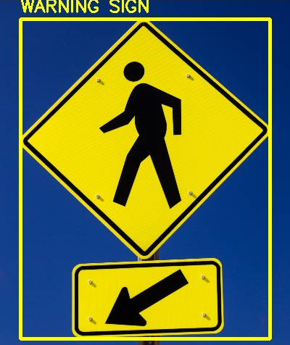

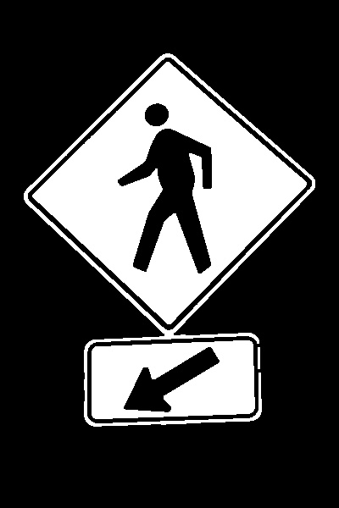

STEP 1: COLOR MASKING
1. RGB TO HSV
Standard color spaces fail under varied lighting. We convert the image to HSV (Hue, Saturation, Value) to reliably isolate pure Red, Yellow, Green, and Blue.
2. MORPHOLOGICAL CLEANING
Raw masks are noisy. We deploy structural operations: Opening: Erases small specks of noise on the asphalt. Closing: Fills structural gaps inside the sign boundaries.
Notes:
Ishaan

Slide 6

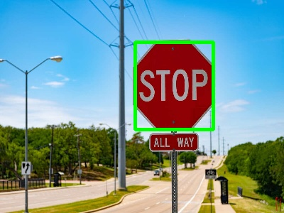
STEP 2: SHAPE & CONTOURS
Once colors are isolated, we extract contours—the geometric boundaries of the colored regions.
Area Filtering: Contours that are too small (noise) or too large (sky/background) are immediately discarded.
Geometric Ratios: We calculate perimeter, bounding box aspect ratio, and circularity to classify octagons, triangles, and rectangles.
Hough Circle Transform: Standard polygons aren't enough for traffic light bulbs and speed signs. We run a mathematical circle detection specifically on filtered candidates.
Notes:
Ishaan

Slide 7

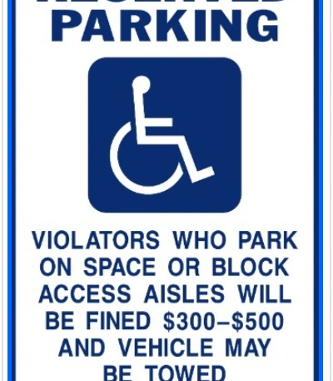

STEP 3: TEXT READING
TEMPLATE MATCHING
To read simple text and identify strict symbols, the system analyzes the dark pixels inside the established bounding box.
We use classical OpenCV template matching to identify:
•
Speed limit digits (e.g., 50, 60, 80)
•
Regulatory words (STOP, YIELD)
•
Navigational symbols (Arrows, Crosses, Slashes)
Notes:
Manish
We implemented a lightweight template-based text reader.
It uses thresholding and OpenCV template matching to recognize common traffic sign numbers or keywords.
Start From A Detected Sign Box and crop it
Clean any noise
Find Dark Text Pixels and thresholds BGR to HSV. for eg: black digits on speed signs
findContours
Normalize and then compare with template

Slide 8






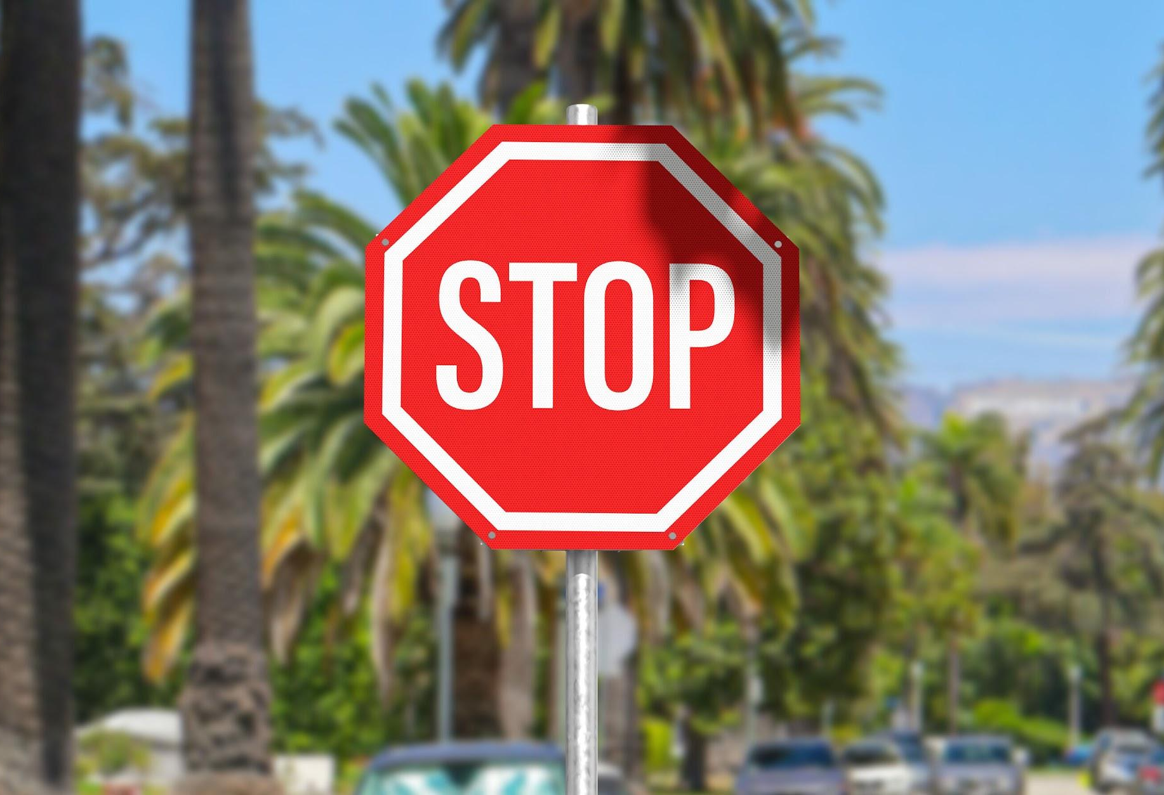
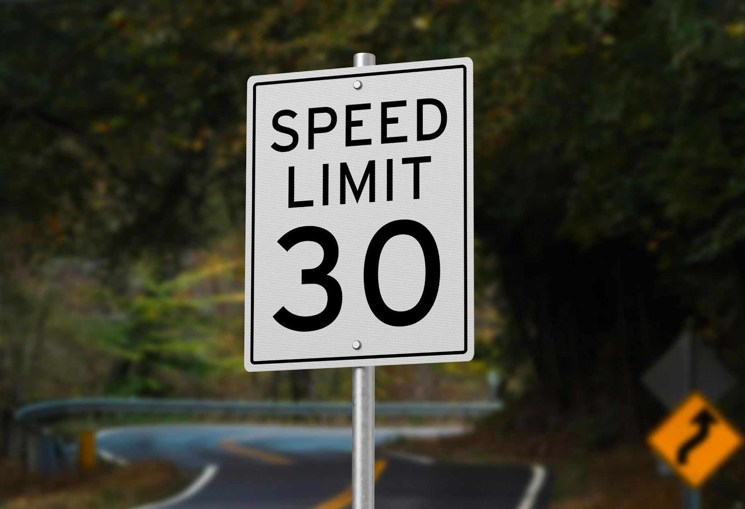
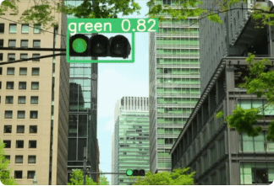
STEP 4: RULE-BASED DETECTION
The pipeline locks in a classification only when Color + Shape + Internal Text requirements are met.
Red + Octagon + "STOP"
Circle/Rect + Number
Green + Hough Circle
STOP SIGN
SPEED LIMIT
GO STATE
Notes:
Manish
Convert Image To HSV
Create Color Masks
Check If The Shape Looks Like A Bulb
The code checks if the candidate is circular using:
contour area
perimeter
circularity
bounding box
Hough circle detection

Slide 9
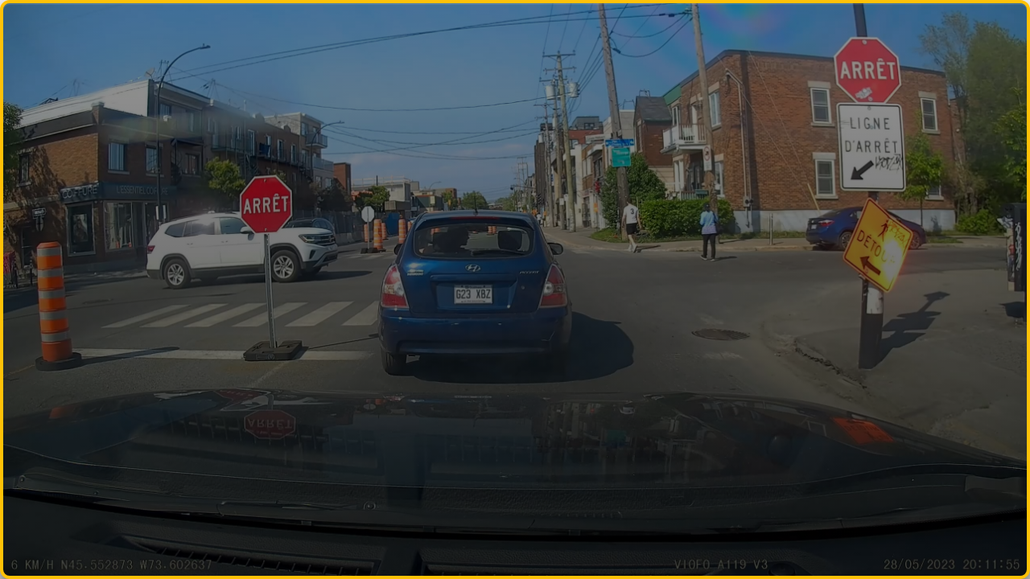


ROAD SIGN DEMO
CLICK TO PLAY VIDEO
Notes:
Ishaan

Slide 10
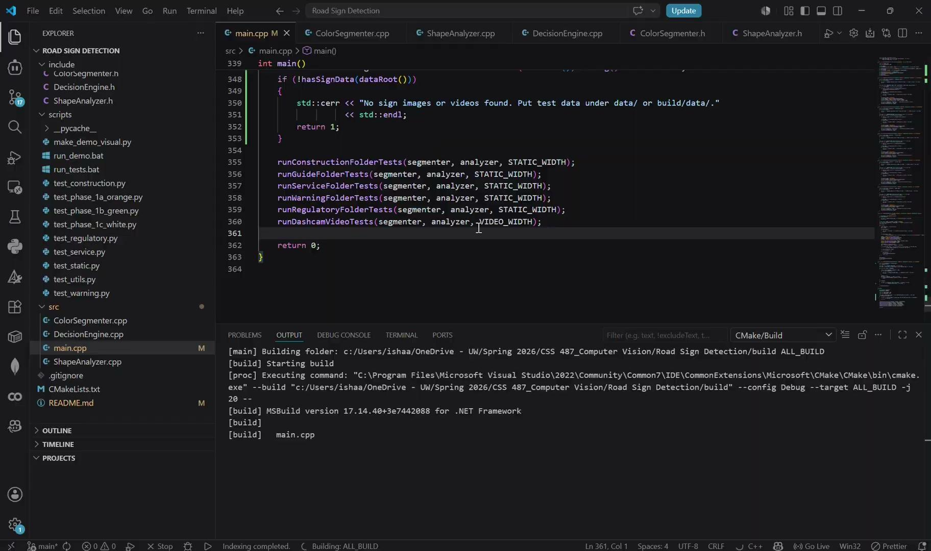
Notes:
Ishaan

Slide 11
TRAFFIC LIGHT DEMO
CLICK TO PLAY VIDEO
Notes:
Manish

Slide 12
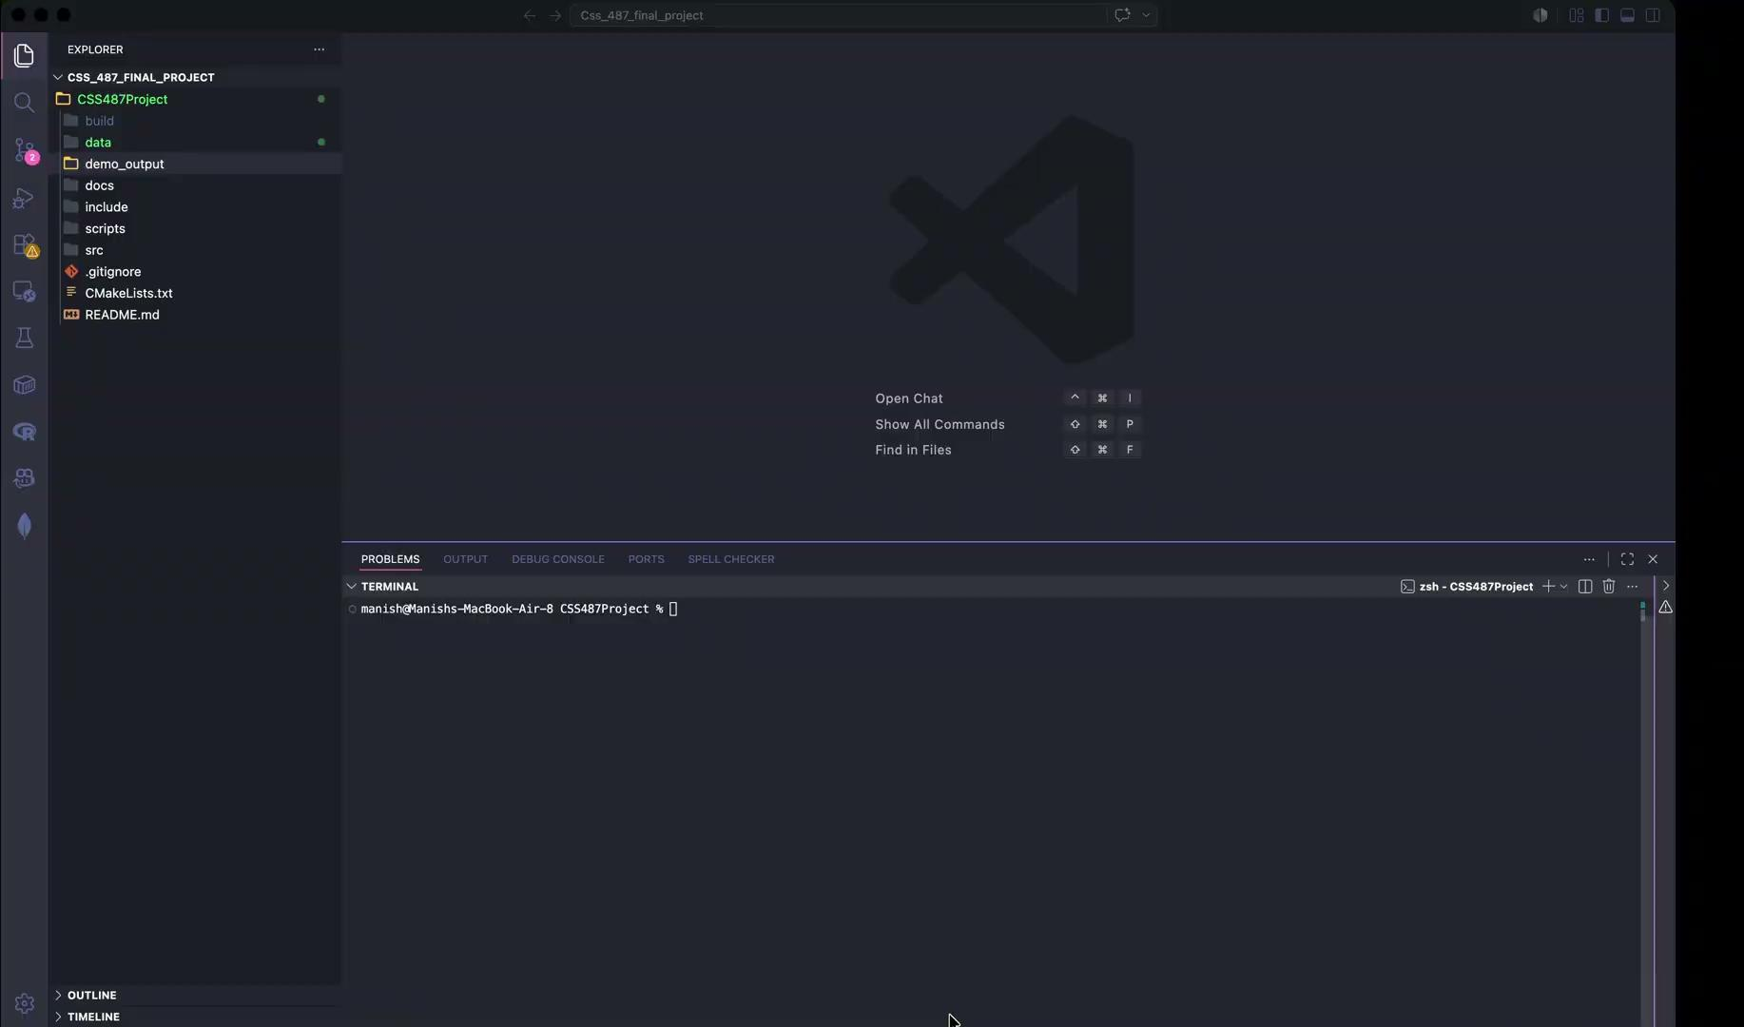

Slide 13
LESSONS LEARNED
Highly Explainable Logic Unlike black box neural networks, every detection in our C++ pipeline stems from a traceable geometric or color calculation. It is completely transparent.
Sensitivity to Lighting Because the system relies heavily on pure HSV thresholds, it struggles significantly with poor lighting, heavy shadows, and night time driving scenarios.
Vulnerability to Motion & Angles Motion blur from the car, unusual camera angles, or partially blocked signs distort the object's contours, ruining template matching capabilities.
Algorithmic Foundations While modern ML is superior for production, building this pipeline manually provides an indispensable understanding of core image processing fundamentals.
Notes:
Manish

Slide 14

END OF ROUTE
Any Questions?
CSS 497 • COMPUTER VISION
Notes:
Manish

Slide 15






IMAGE SOURCES
https://miro.medium.com/v2/resize:fit:1400/1*SLqwl7kfDJJaMKtjsXlsFQ.jpeg
Source: medium.com
https://miro.medium.com/1*NTI0ce3e1chzhHmBxTzjsw.png
Source: medium.com
https://cdn.prod.website-files.com/65855f99c571eeb322e2b933/693a3c4c462a1b4499c8775a_bounding-box-hero.jpeg
Source: www.sama.com
https://preview.redd.it/open-source-ocr-models-2026-to-fine-tune-for-dot-peen-on-v0-mrvtqwt5mr4h1.jpg?width=640&crop=smart&auto=webp&s=8f834f9f9e996d420a553eedb959ae8577ceb34f
Source: www.reddit.com
https://source.roboflow.com/y3makLU5XIPaEBAcTaJ8YQqYmnA3/00qzEq2xtXfI35uiL1LB/thumb.jpg
Source: universe.roboflow.com
https://dss-www-production.s3.amazonaws.com/uploads/2023/12/maxresdefault-1.jpg
Source: www.datasciencesociety.net

Slide 16



IMAGE SOURCES
https://kajabi-storefronts-production.kajabi-cdn.com/kajabi-storefronts-production/file-uploads/blogs/22606/images/4b8e478-d6da-bbe4-adde-3546fe0e2b_ezgif.com-gif-maker_7_.gif
Source: www.augmentedstartups.com
https://images.unsplash.com/photo-1559376443-565ca7e29a38?fm=jpg&q=60&w=3000&auto=format&fit=crop&ixlib=rb-4.1.0&ixid=M3wxMjA3fDB8MHxwaG90by1yZWxhdGVkfDE0fHx8ZW58MHx8fHx8
Source: unsplash.com
https://external-preview.redd.it/dash-cam-just-two-dumdums-on-the-road-one-who-doesnt-use-v0-cR855D5ZaQMp9W2-T7vlzsFrd_uaRXXXTfhhWqsfXkw.png?format=pjpg&auto=webp&s=64086d4acb9ff898c26dd4fcf591a68c1c78d865
Source: www.reddit.com

Slide 17
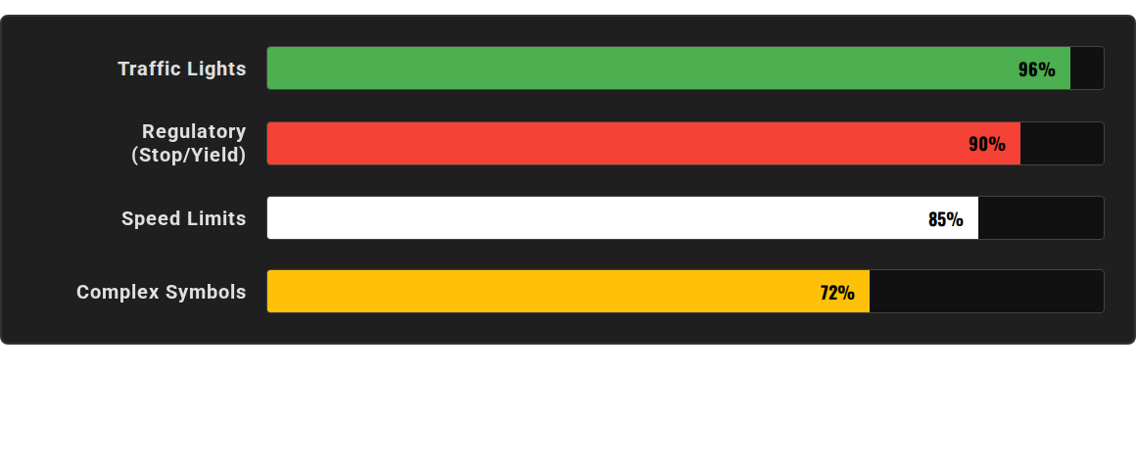
SYSTEM ACCURACY METRICS
High contrast, standardized signs yield the highest accuracy. Performance drops on complex symbols due to the rigid nature of classical template matching.
Notes:
Manish

